Slide 1
生物医学电子 课题六答辩报告
Biomedical Electronics
Topic 6
Final Report

Slide 2

EEG情绪识别实践 EEG Emotion Recognition Practice
Team Members:
小组成员：
陈兴基 宋子洋 聂诗茂 张腾霄 唐健涵 刘震

Slide 3
What is EEG emotion recognition?
Emotion recognition refers to the identification of people's emotional changes under external stimuli, which is widely used in psychological state detection, crime prevention, disease treatment and other fields. In recent years, EEG electrical signals have received more and more attention for emotion recognition. As EEG is a direct response of electrical signals in the brain, it has a more intuitive performance compared with ECG and dermatograms, which rely on sympathetic parasympathetic nerve regulation. For example, EEG signals have a wide spatial and frequency distribution difference under different emotions, so EEG signals have a better classification and recognition effect of emotions.

Slide 4
Emotion is a general term for a series of subjective cognitive experiences, including people's psychological reactions to external stimuli or their own stimuli, as well as their accompanying physiological reactions. American psychologist William James and Danish physiologist Carl Lange proposed the definition of emotion in 1884 and 1885 respectively. This is the famous James-Lange Theory, which holds that emotion is an inevitable outcome of the activities of the vegetal nervous system. Physiological psychologist Walter BradfordCannon challenged this theory and proposed that the thalamus, the central nervous system, is the central system that really affects mood. Student Philip Cannon passed by. Bard's research and expansion led to the Cannon- Bard theory of emotion. In the 1960s, S.Schachter andJ.Singer conducted experiments and found that emotion is actually the result of brain processing after the combination of the surrounding environmental state and individual physiological state. This theory is called S.Schachter-J.Singer theory. Psychologist Richard StanleyLazarus pointed out that the essence of emotion is an individual's perceptual response to things in his or her environment, resulting from the interaction between a person and the environment.

Slide 5
Emotion plays a very important role both in the individual itself and between individuals and others, as well as between individuals and social life. Therefore, the research on emotion recognition is of great significance both in theory and in practical application.Correct emotion representation is the key step of emotionrecognition research. For emotion representation, manyresearchers have proposed corresponding emotion representationmethods, mainly including the following categories:
1.The classification of emotions is called discrete model theory. The theory holds that complex emotions are a combination of basic emotions. Plutchik et al. identified eight basic emotions: anger, fear, anticipation, sadness, disgust, surprise, acceptance and joy, and suggested that other complex emotions could be formed from combinations of these basic emotions.
2.The dimensional representation of emotions is called continuum model theory. The theory maps emotion to the V-A-D three-dimensional model of valence, arousal and dominance, and uses multidimensional continuous variables to characterize emotion. The representation of continuous model can vectorize emotion and has good expansibility. In recent years, this model has become more and more dominant in emotional computing.

Slide 6
Electroencephalography (EEG) is a medical imaging technique that measures the electrical activity of the scalp generated by the brain. That is, it measures and records in chronological order the fluctuations in electrical potential on the surface of the scalp caused by ionic currents within the lion cells of the brain. The research shows that the cognitive behavior and mental activity have strong correlation with eeg signal. The voltage of an adult's electrical signal is about 10 to 100 microvolts. The signals collected by EEG are converted into frequency domain by Discrete FourierTransform (DFT), Fast FourierTransform (FFT) and other algorithms, which contain continuous spectral signals. These signals are divided into five frequencybands: delta(1-4 hz), theta(4-7 hz), alpha(8-13 hz), beta(13-30 hz), and gamma(30-47 hz).

Slide 7
Delta frequency range is usually less than 4Hz. Studies have shown that eeg signals in this range usually occur during infancy or immature mental development, or in adults during fatigue and deep sleep.
Theta frequency range is about 4-7Hz. In teenagers (10 to 17 years old), this range of eeg signals appear more, when people are in a relaxed or light sleep may also appear this band signal, often appear in the frontal lobe; In adults with depression or psychosis, this frequency wave is also very obvious, often in the temporal parietal lobe.
Alpha frequency range is about 8-13Hz. This range of signals usually occurs in the occipital lobe when the person is in a quiet, awake, closed state of mind, and when the eyes open or other external stimuli, the alpha wave will disappear.
Beta wave frequency range of about 13-30Hz, human logic analysis and other main eeg components, mainly concentrated in the frontal lobe of the brain. When a person is awake or nervous, emotional, the brain is prone to produce this frequency signal.
Gamma wave frequency is about 30-47Hz, which is the highest frequency component of eeg signal. Gamma waves tend to occur when people are focused on something or are alert.

Slide 8
The above is a quick introduction of EEG, Next part is he modeling method that we use.

Slide 9
Task Requirements
In this experiment, for the public emotion dataset DEAP, the experiment was conducted to dichotomize and quadruple classify the Valence and Arousal of different subjects' emotions

Slide 10
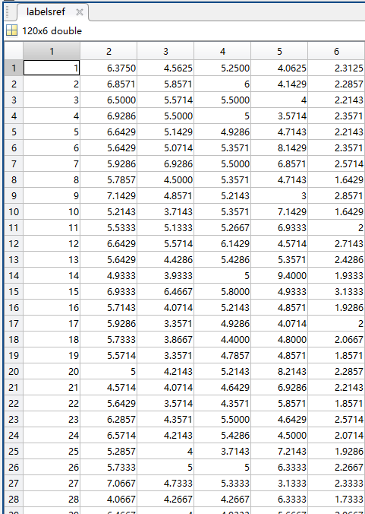
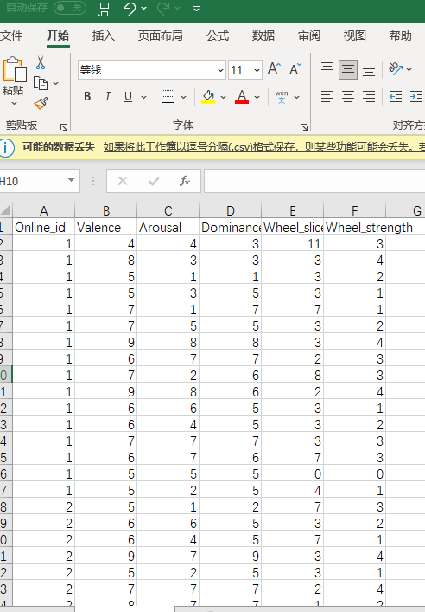
Online Rating.csv
Popular rating for 120 video clips.
We calculated the Average of each item for each clips. (0-9 scored)
And We can find details in videos list.csv to match the emotion of per experiment.
40 were picked as experiments out of 120 clips.

Slide 11
Emotion Recognition for Videos - Quadruple classify (四分类)
RED = HIGH,HIGH
YELLOW = LOW,HIGH
GREEN = HIGH,LOW
BLUE = LOW,LOW

Slide 12

PCA(principal component analysis,主成分分析)
主成分分析(PCA)的详细解释 - 知乎 (zhihu.com)

Slide 13
Emotion Recognition for Videos - Dichotomize (二分类)
Processing the value of video clips into 1-Demension by PCA

Slide 14
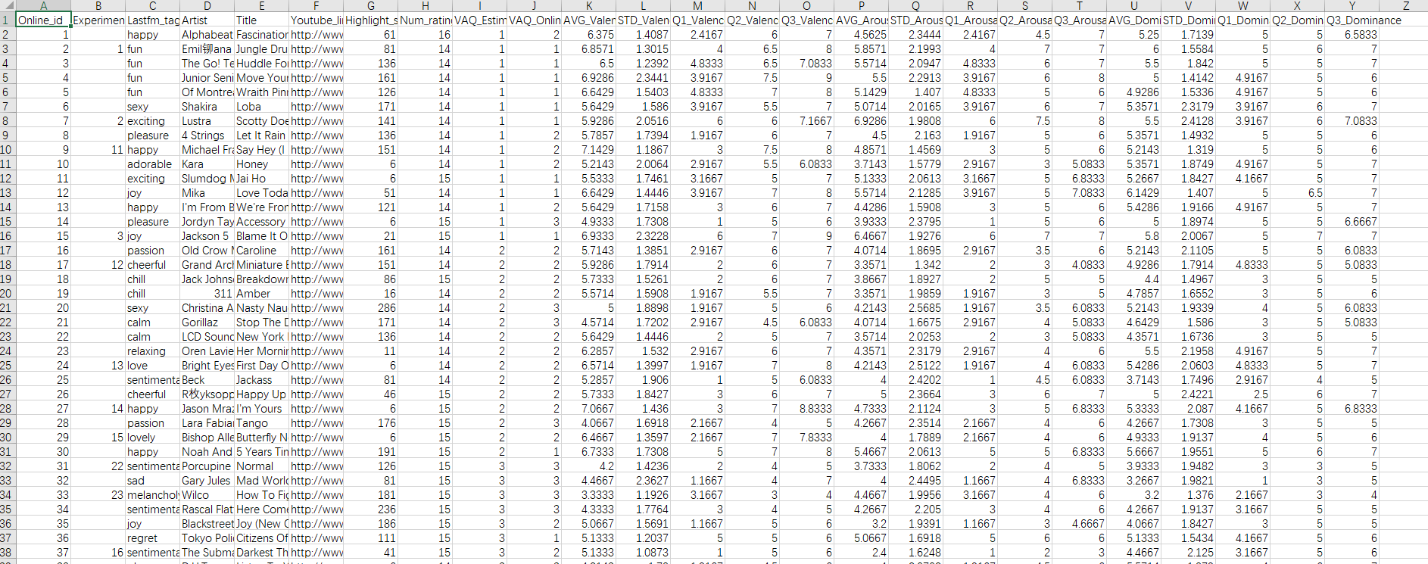
Video list.csv
Giving information about the selection of emotion Experiment using, and label references.

Slide 15
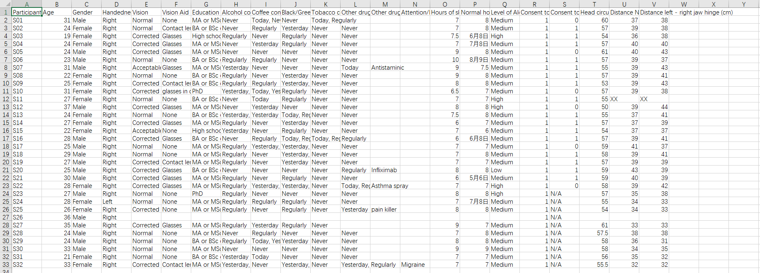
Participant questionnaire.csv
Displays all the participants’ Information of Health, Useless currently

Slide 16
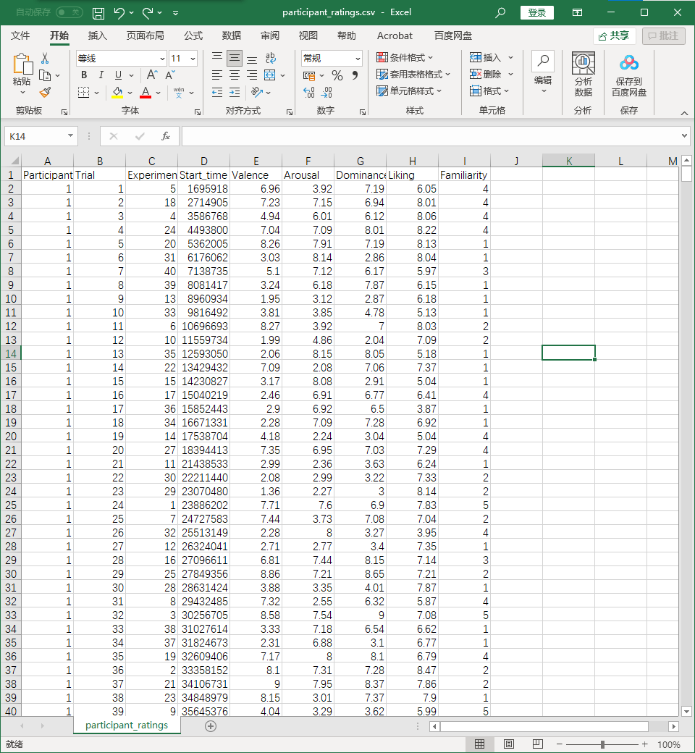
Participant rating.csv
References of Labels and marking the Experiment plot
Giving Examples for training sets and testing sets.
Useful and explain more detailed in the next part

Slide 17
Signals & Data Processing

Slide 18
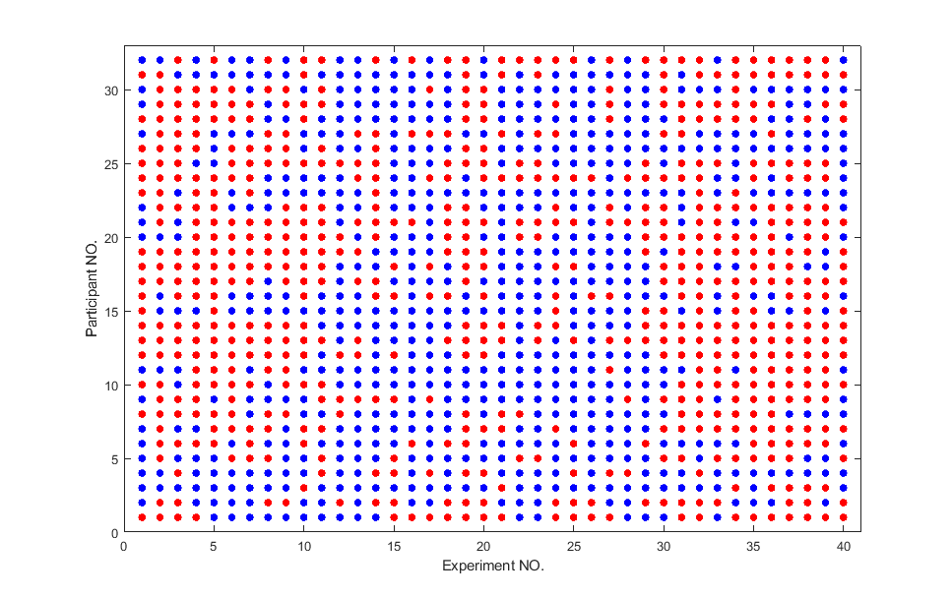
Participant Rating.csv - Dichotomize (二分类)
RED – Positive
BLUE - Negative

Slide 19
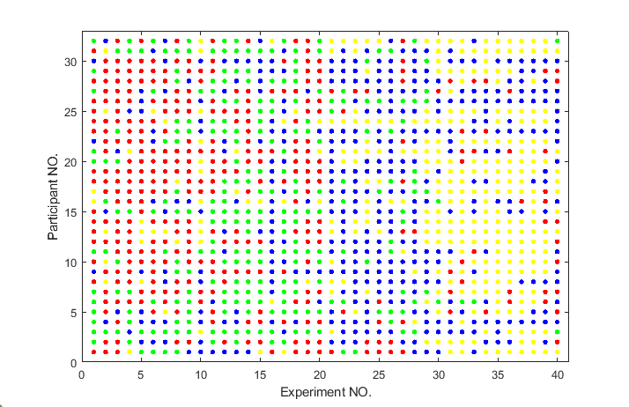
Participant Rating.csv - - Quadruple classify (四分类)
RED = HIGH,HIGH
YELLOW = LOW,HIGH
GREEN = HIGH,LOW
BLUE = LOW,LOW

Slide 20
Emotion Recognition for EEGs – for each participant
Pick 4 channels out of 40.
Resolving Datapoints
into Time Domain.
Dataset:
32 candidate*
40 tests*
40 knots*
8064 Discrete Datapoints
Labels ( 4 for each test) :
Valence, Arousal, Dominance, Liking

Slide 21
Emotion Recognition for EEGs
Pick 4 channels out of 40.
Transferred into
Freq-Domain
And added filters to get
certain wave (α,β,δ,θ)

Slide 22
Algorithm Analysis
Building models and Fitting them with training sets
Examining the model with testing sets and evaluate the result
Giving out codes and statements of algorithm validity

Slide 23
Algorithm validity - Naive Bayes and Fisher/Linear Discriminant (68%)

Slide 24
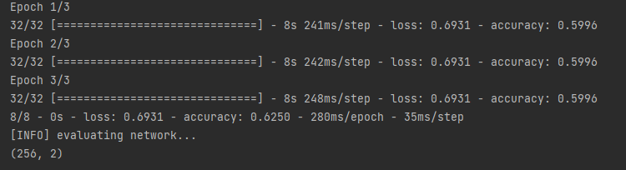
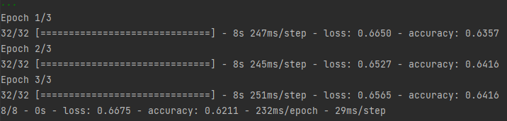
Algorithm validity –Machine Learning (62%)

Slide 25
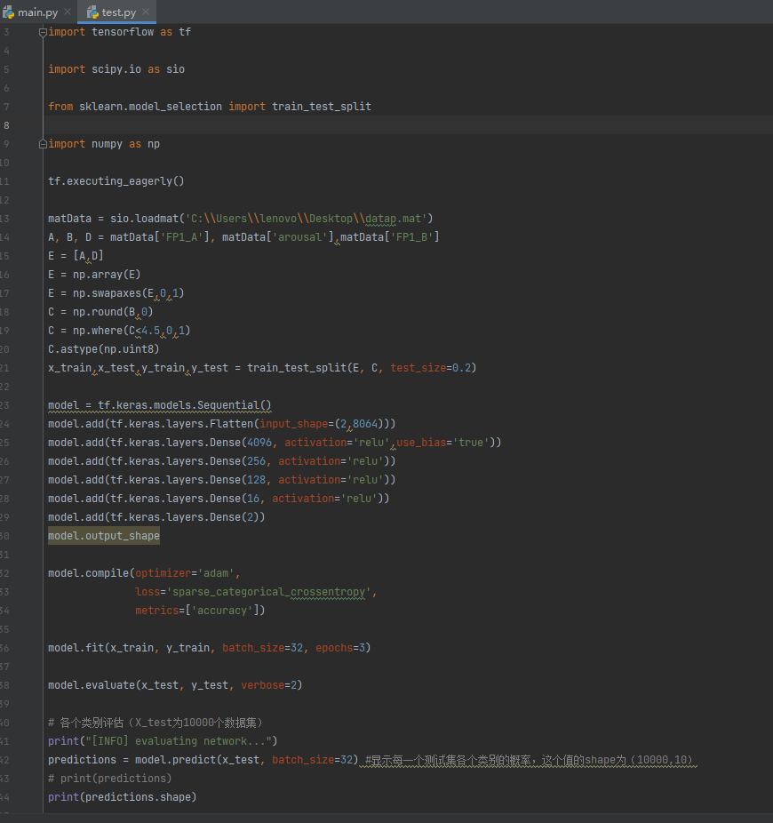



Result Code - ML
Result Screenshots, using :

Slide 26


Slide 27


Slide 28
Next part is our code. (MATLAB- Naive Bayes and Fisher/Linear Discriminant )
Preprocessing
Dichotomisation
Plot Time/Freq Domain Wave and check out 4 certain freq-bands
PCA (main)
Naive Bayes and Fisher/Linear Discriminant Fit
Assessment

Slide 29
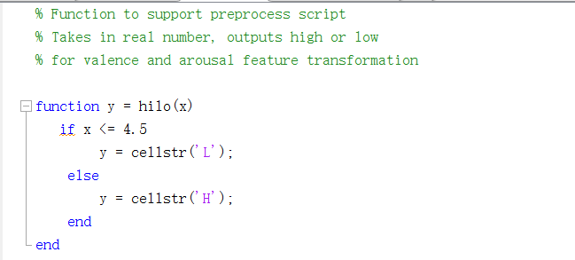
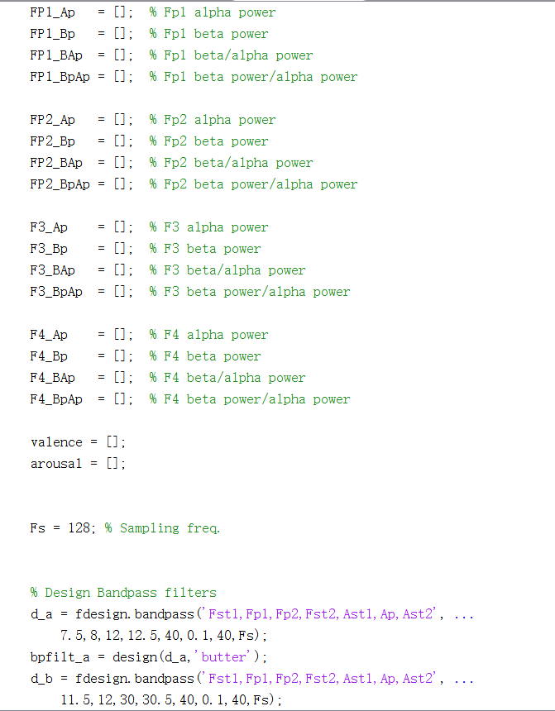
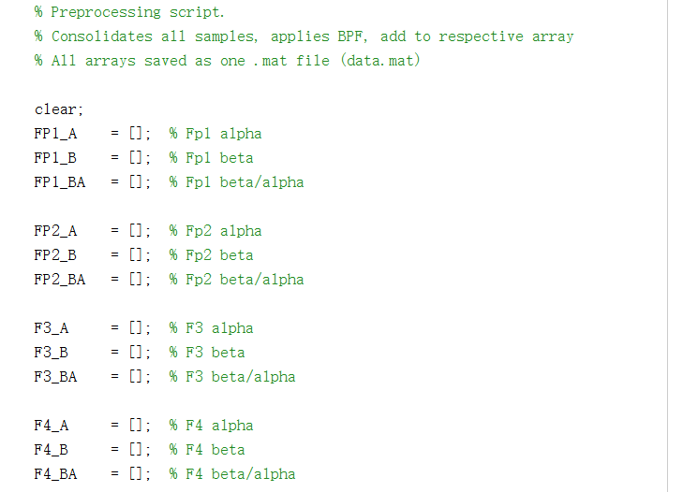
Dichotomisation
To Labels
Preprocess
To Data

Slide 30
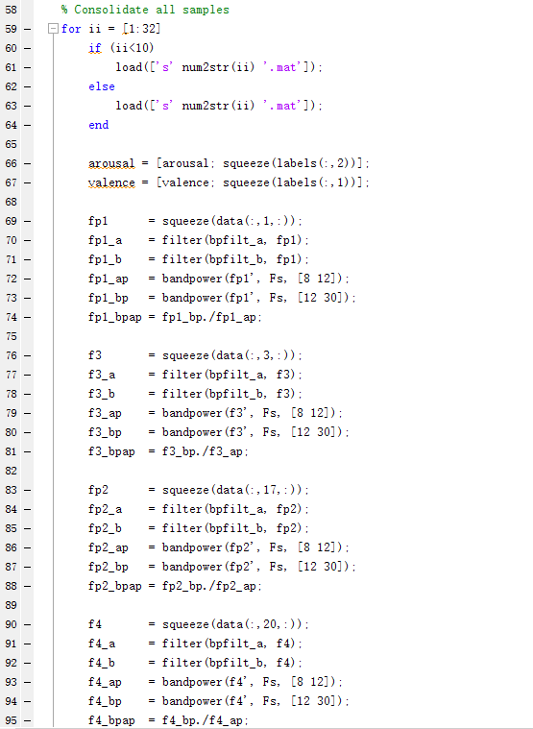
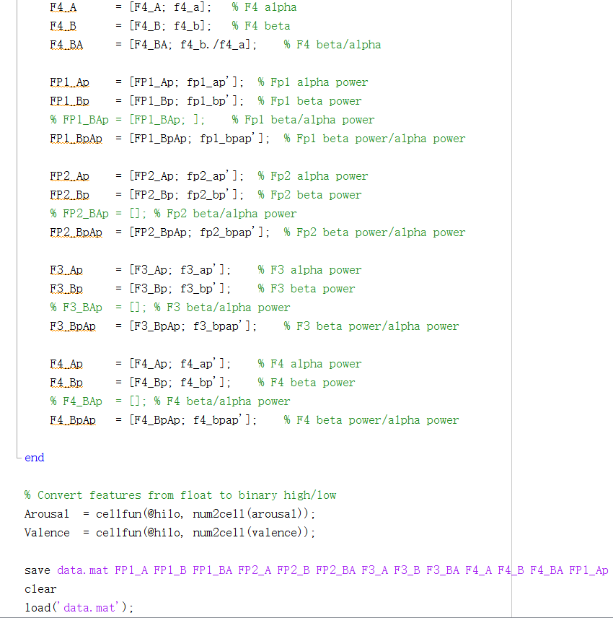

Slide 31
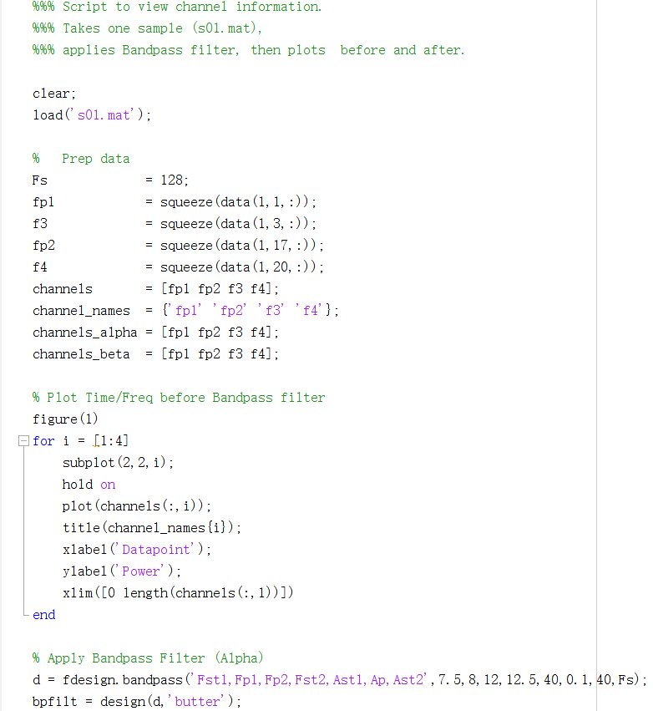
Plot channel Info – Power density,etc.

Slide 32
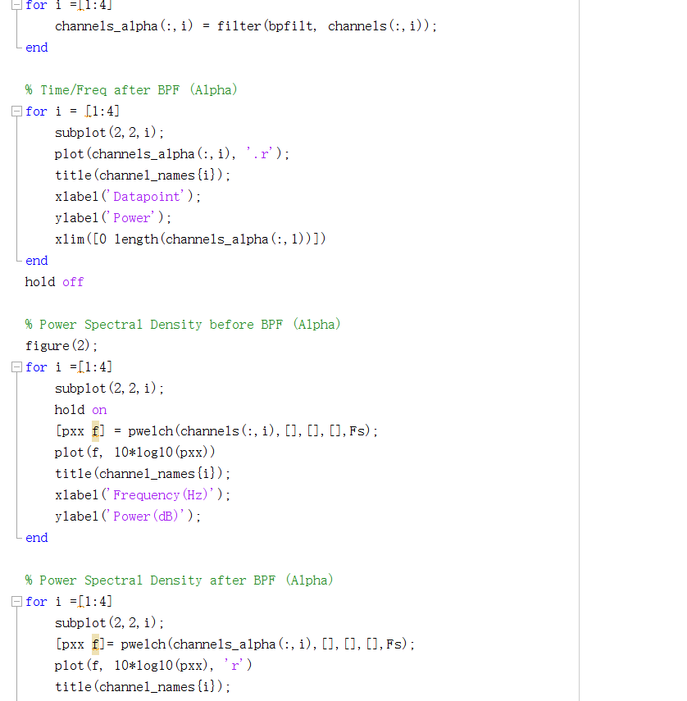
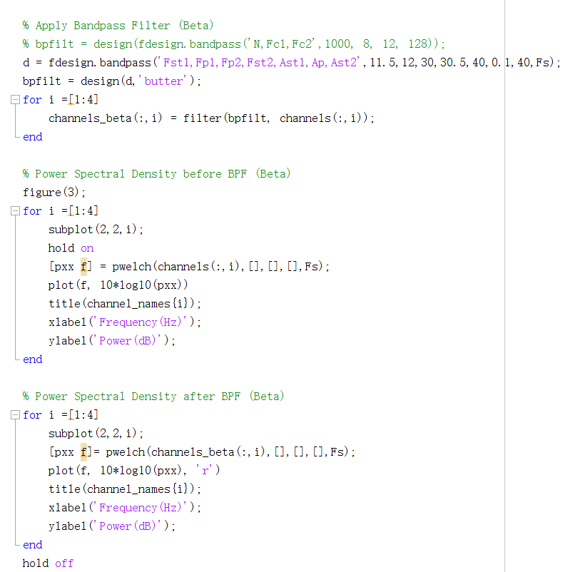

Slide 33
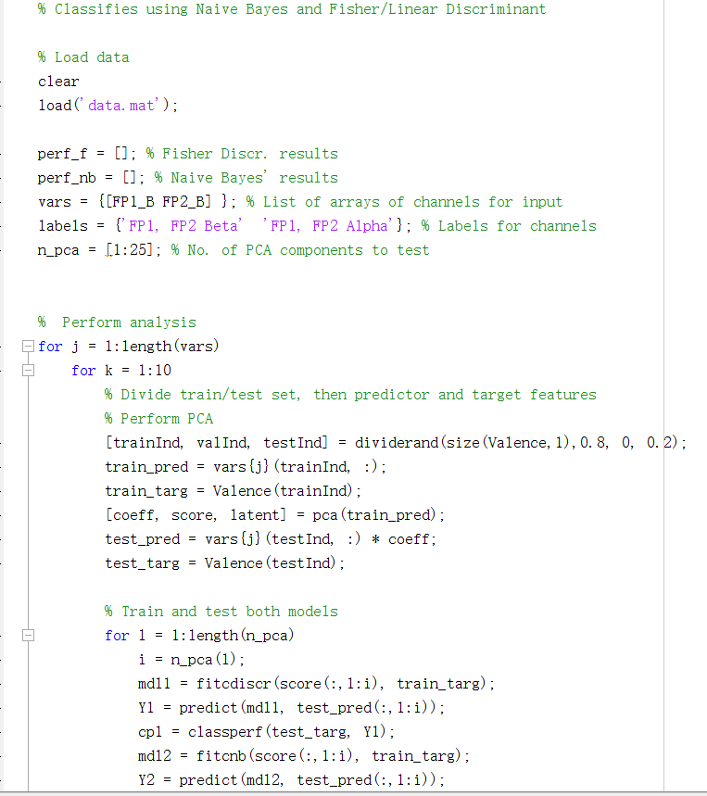
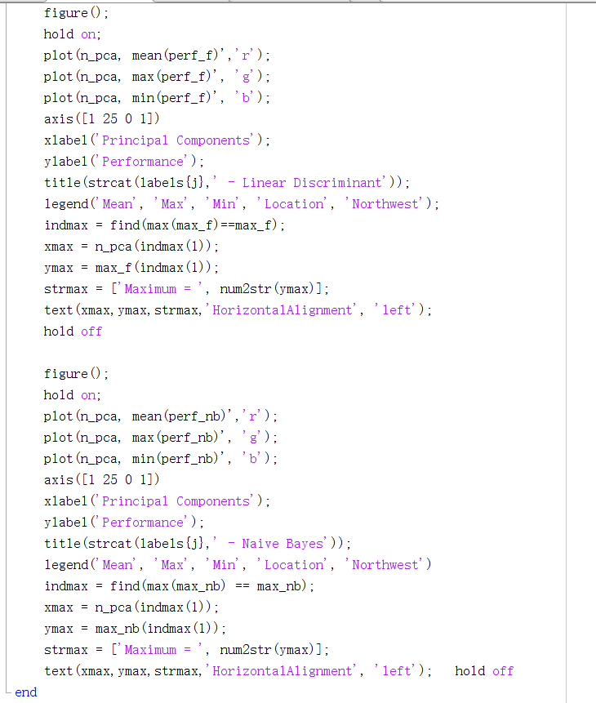
Applying PCA

Slide 34
EEG Power thermogram & Mapping Analysis
Using EEGLAB to process and plot

Slide 36
Extra Resources & Appendix
For Future Business Plans, Reserch Project Proposals, Lessons, etc.

Slide 37

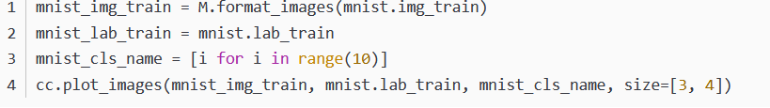
Tensorflow_08C_Keras 的数据增强与 Tensorboard 使用方法
Brief 概述
Import Data 导入数据，使用两种模型MNIST ，CIFAR10
数据导入
MNIST Dataset（测试对数的认知）

Slide 38
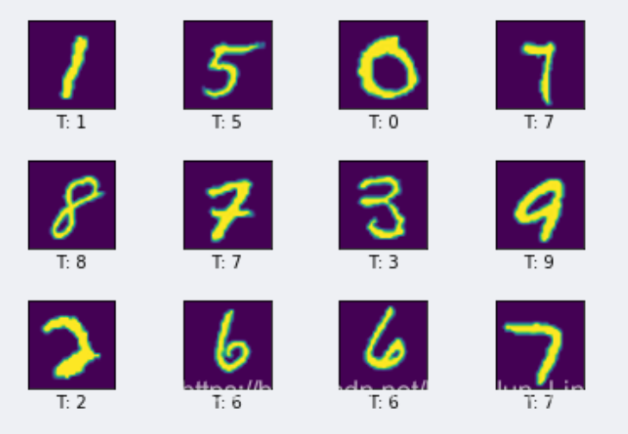
Result for Number Image Recognition

Slide 39
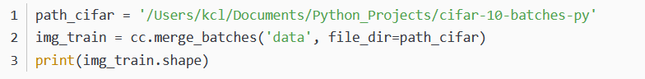
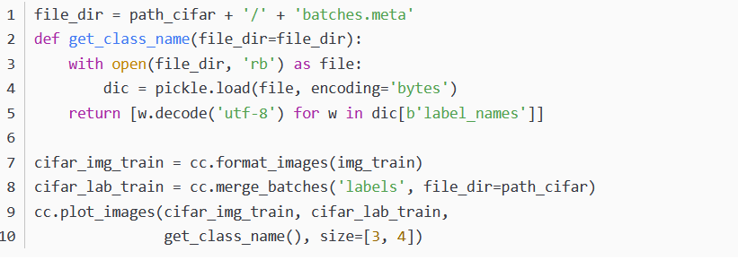
CIFAR10 Dataset（测试对图像的认知）

Slide 40
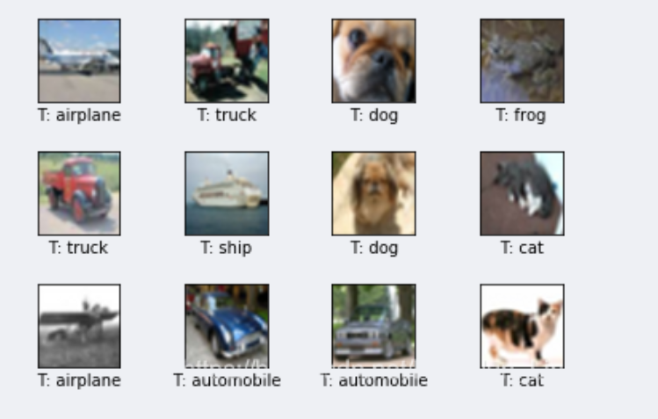
Results for Object Recognition

Slide 41
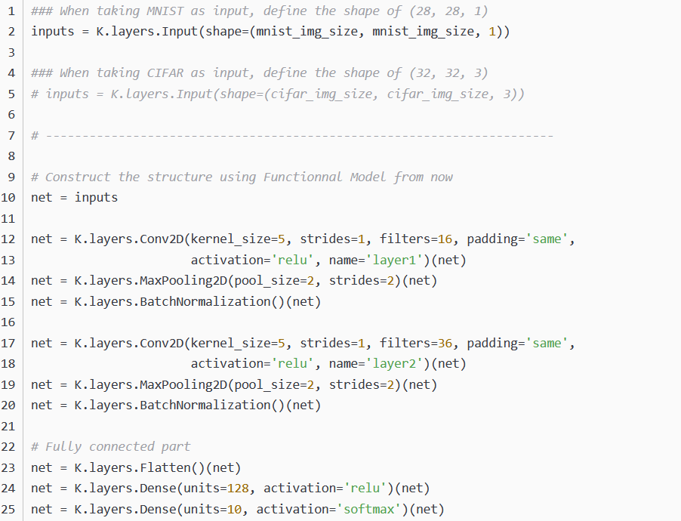
Tensorflow_08B_Keras 的 Function 模型与训练结果的储存方法
Model Construction

Slide 42
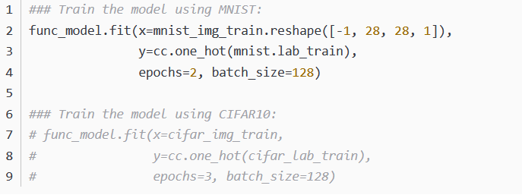
Train Model

Slide 43
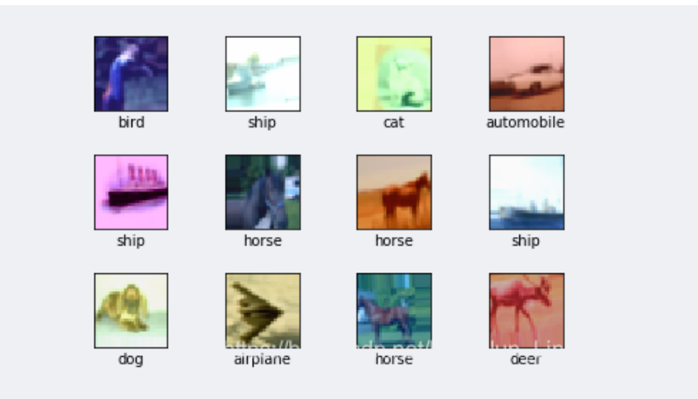
Result

Slide 44
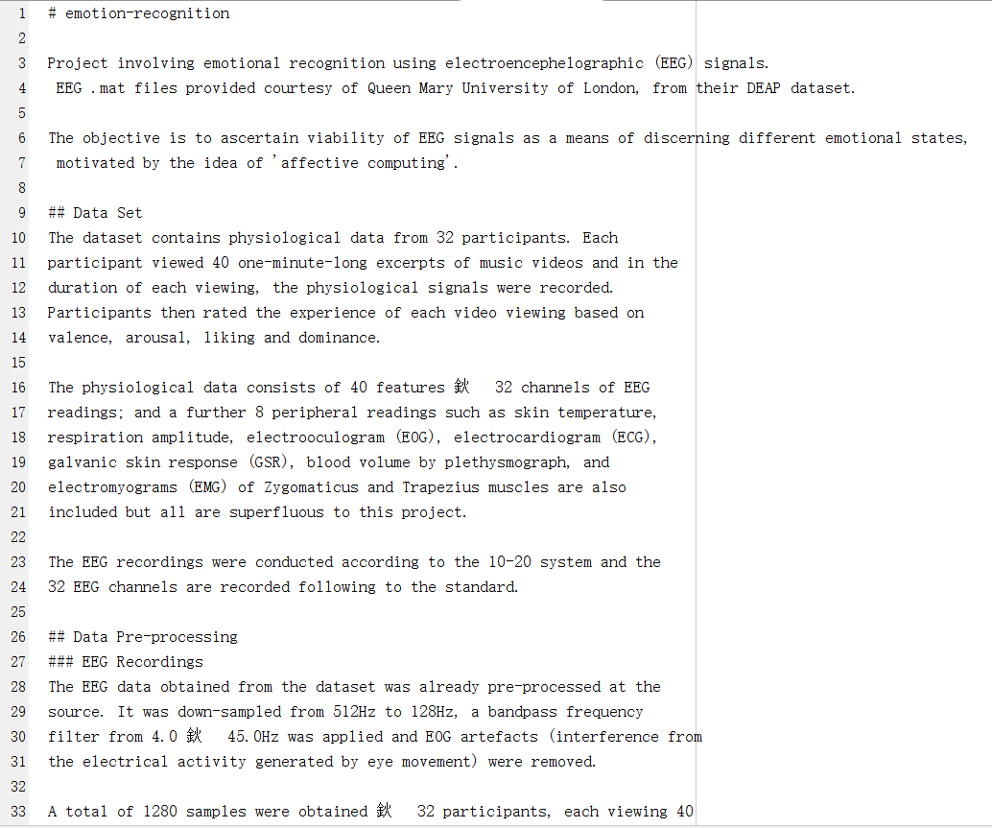
Read Me！

Slide 45
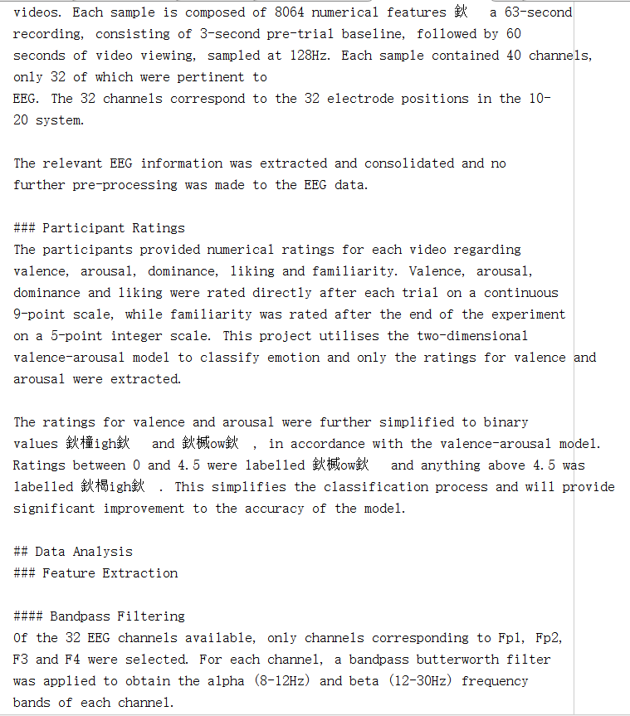

Slide 46
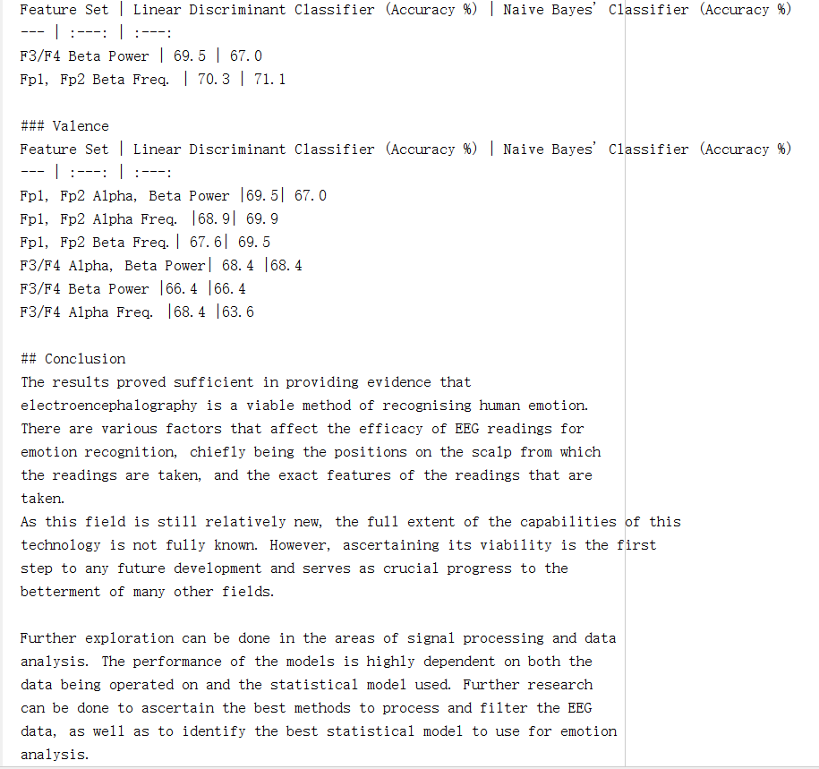

Slide 47
Our report is finished. Thanks for watching!

